Slide 1

Workplace Equity
Optimizing Data-Smart, Equity-Centered Work Environments
GEN
Gender
Equity
Now
Diversity. Equity. Inclusion

Slide 2







Sponsor: Sara Sanford (Founder of GEN)
Team Trailblazers
Emma Grothaus
Gauri Nigam
Vanshika Srivastava

Slide 3

[
[
“Women are still underrepresented in leadership, receive less access to senior leaders and are leaving the fastest-growing sectors, such as tech, at 45 percent higher rates than men”
-Sara Sanford, 2018
“How to design gender bias out of your workplace”
What have businesses been doing to address gender inequality?
Notes:
https://www.ted.com/talks/sara_sanford_how_to_design_gender_bias_out_of_your_workplace/transcript?language=en

Slide 4
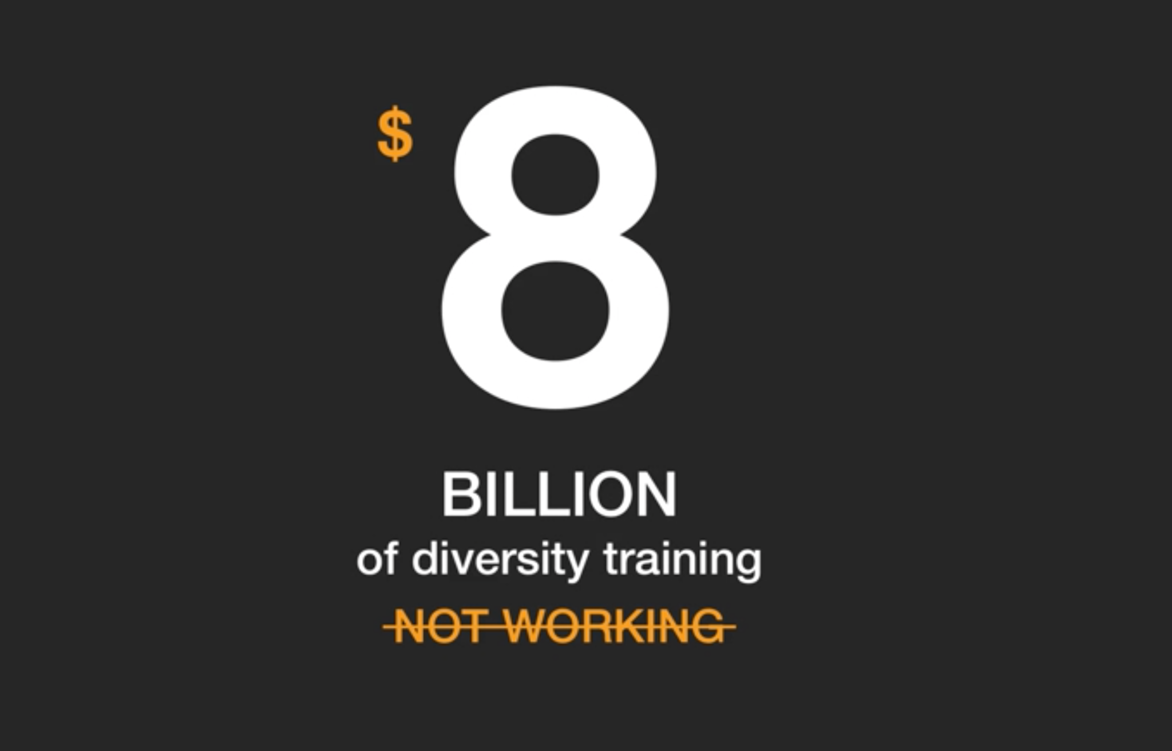
- Sara Sanford, 2018
“How to design gender bias out of your workplace”
Notes:
Many businesses think they're addressing the problem, because they provide training. Eight billion dollars worth of training a year, according to studies from the "Harvard Business Review." These same studies also conclude that these trainings don't work and often backfire.

Slide 5
Why isn’t it working ?
Well…
[
[
“These approaches fail to address the key systematic problem: Unconscious Bias.”
-Sara Sanford, 2018
“How to design gender bias out of your workplace”

Slide 6



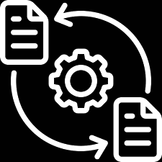


The Opportunity
Working with GEN, we aimed to create a data-driven design framework and prototype for a DEI Dashboard that encompasses an end to end solution driving workplace equity.
DEI Dashboard
Project Assignments
Dynamic progress tracking
Document Upload center
Easy Task Management

Slide 7


The entire solution can be broken down into three broad areas:
Final Deliverable
Requirements Gathering
Research, Prioritize, and Design
Step 3
Step 1
Step 2

Slide 8



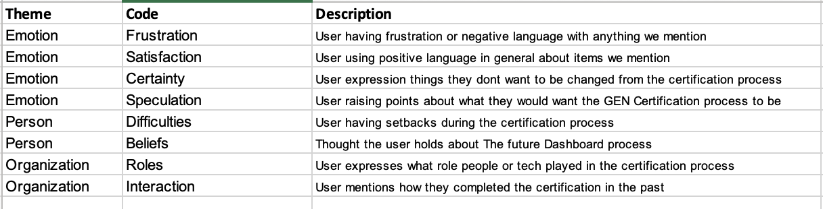
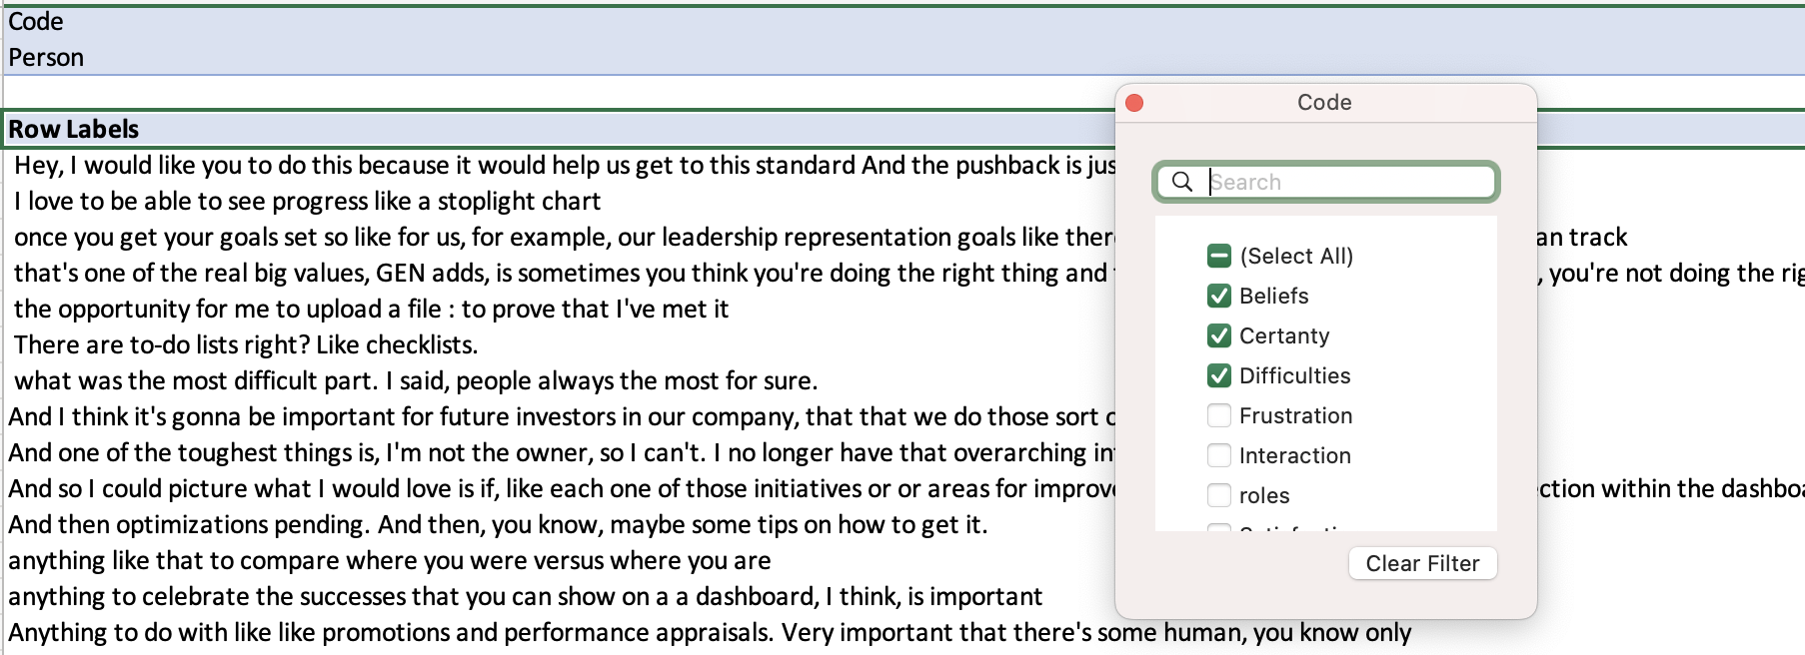
User Interviews
Requirement Gathering
Interview Theming
Understand the specific needs and challenges faced by clients during the GEN certification process.

Slide 9
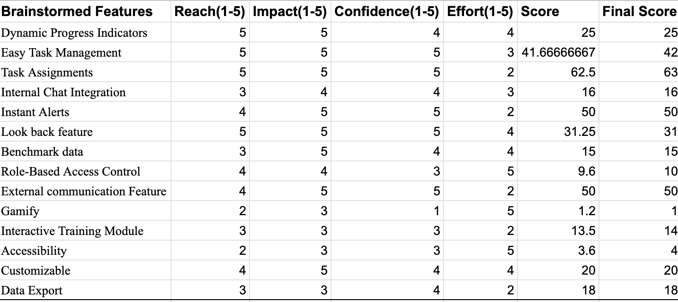
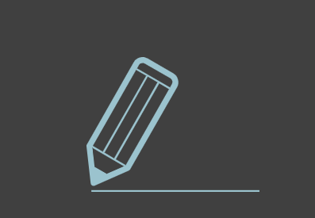
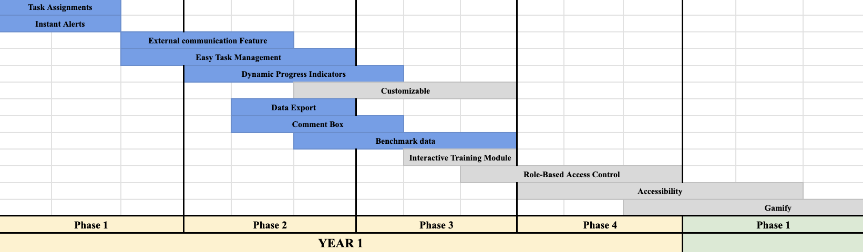
RICE Method
Roadmap
Research and Design
Develop solutions that address the identified requirements, focusing on enhancing the certification process and client management.
MVP Features
Task Assignment
Comment Box
Benchmark Data
External Communication
Dynamic Progress Indicator
Easy Task Management

Slide 10

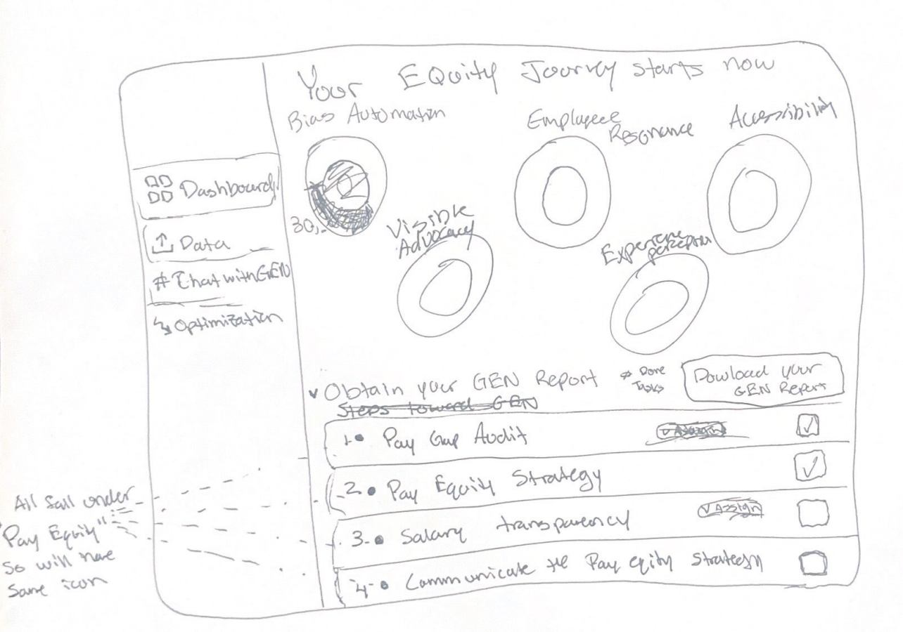
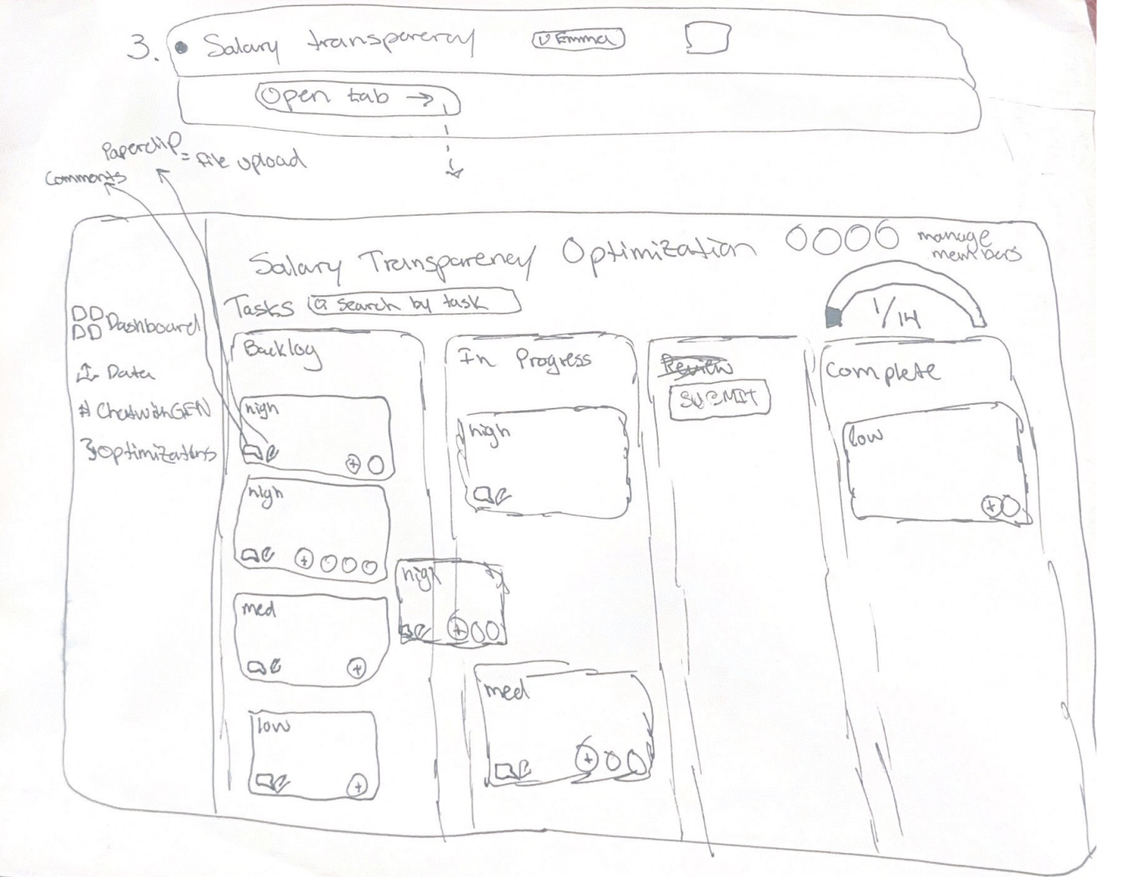
Initial Dashboard Drawings
Data Export Feature
Dynamic Progress Indicator Feature
External Communication Feature
Commenting and file upload feature
Recommendation Assignment Feature
Easy Task Management Feature

Slide 11
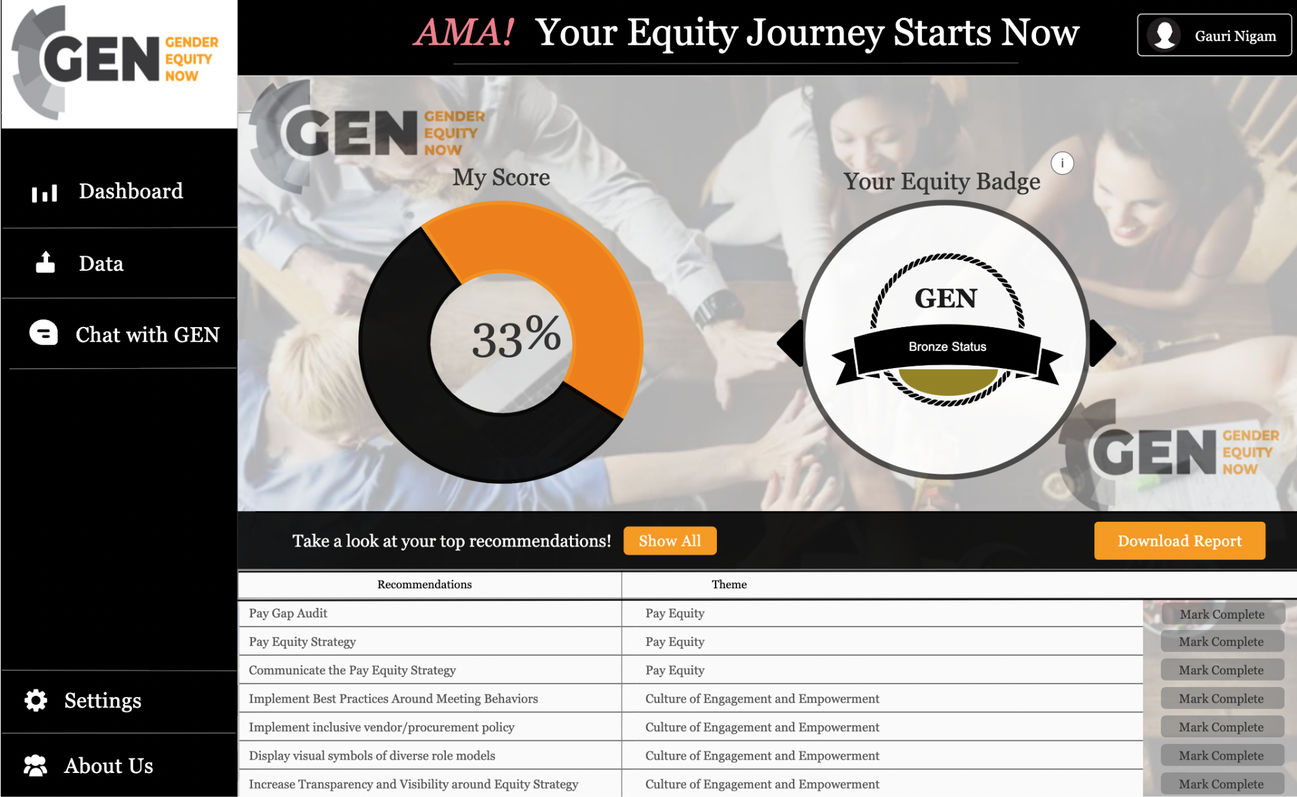
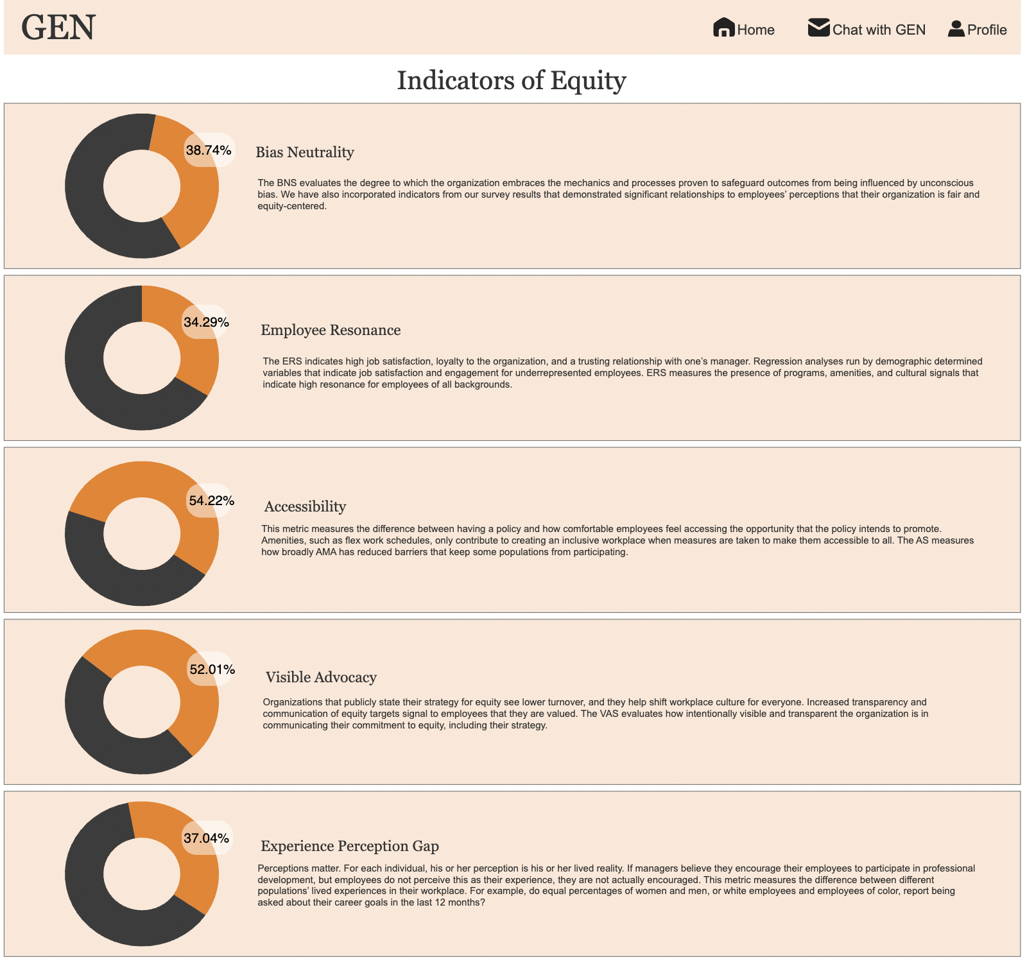

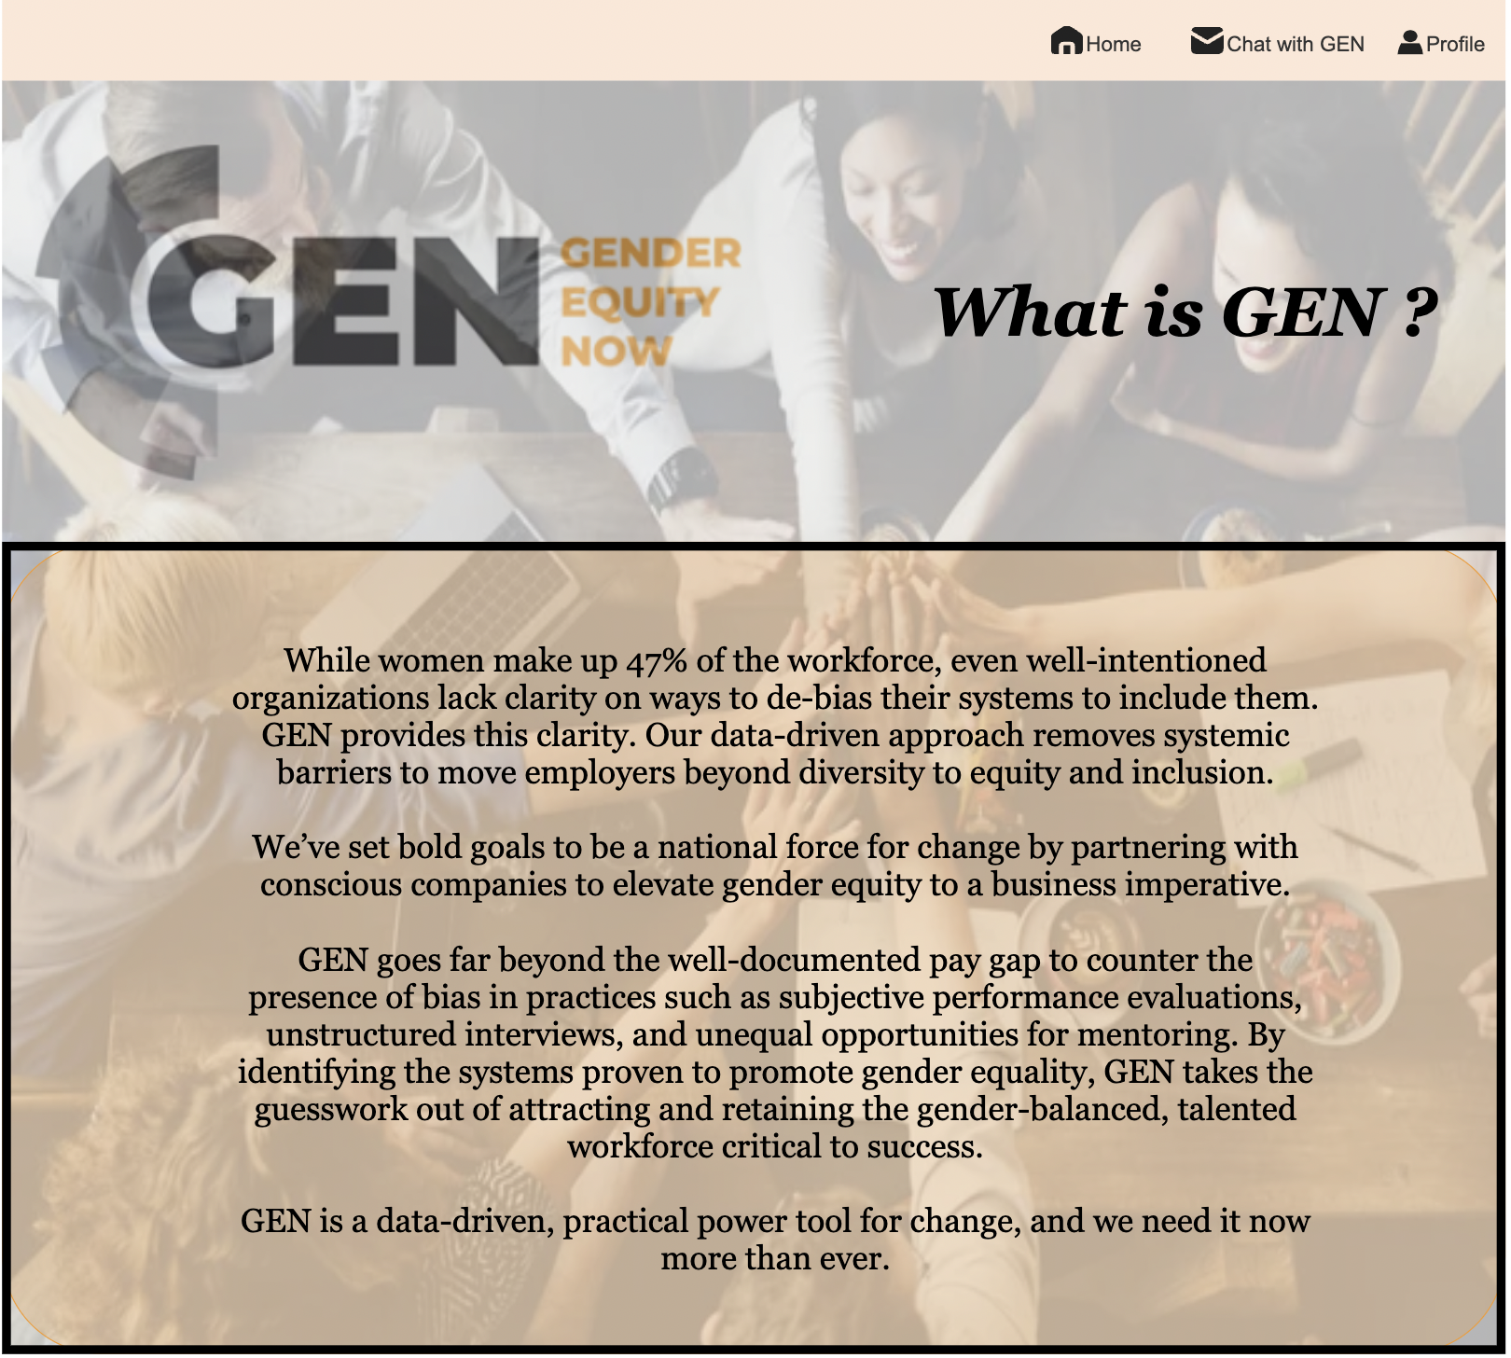
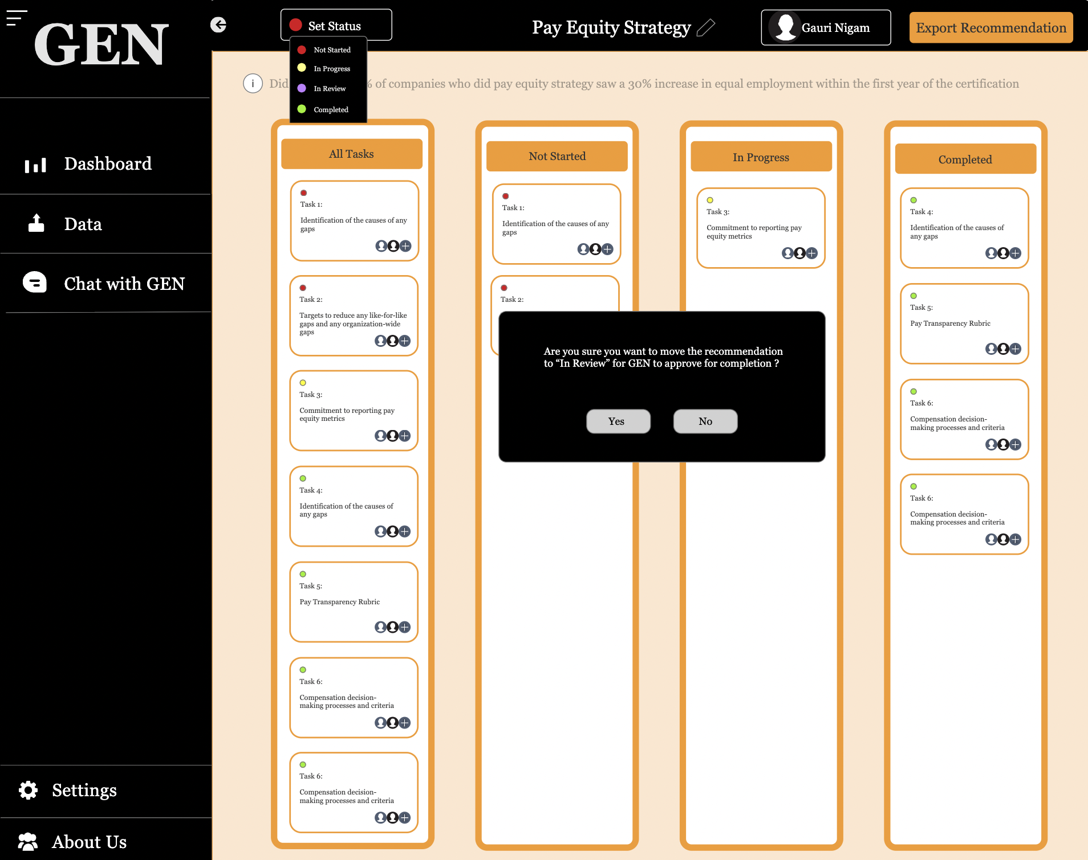
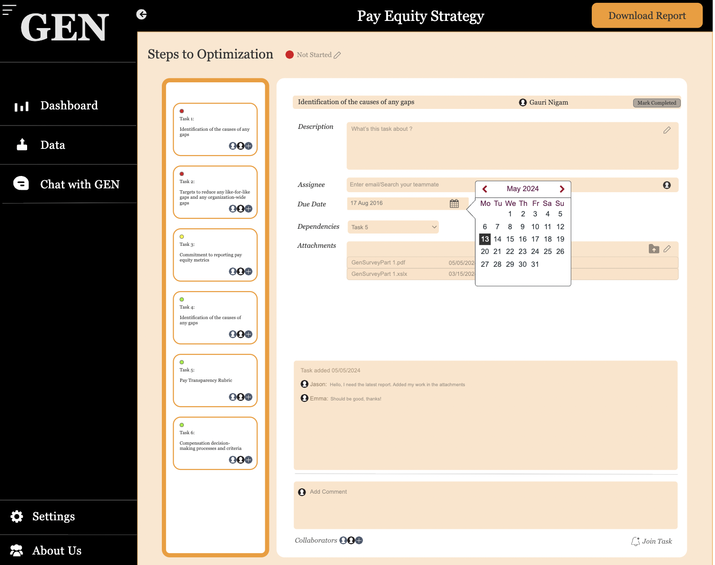
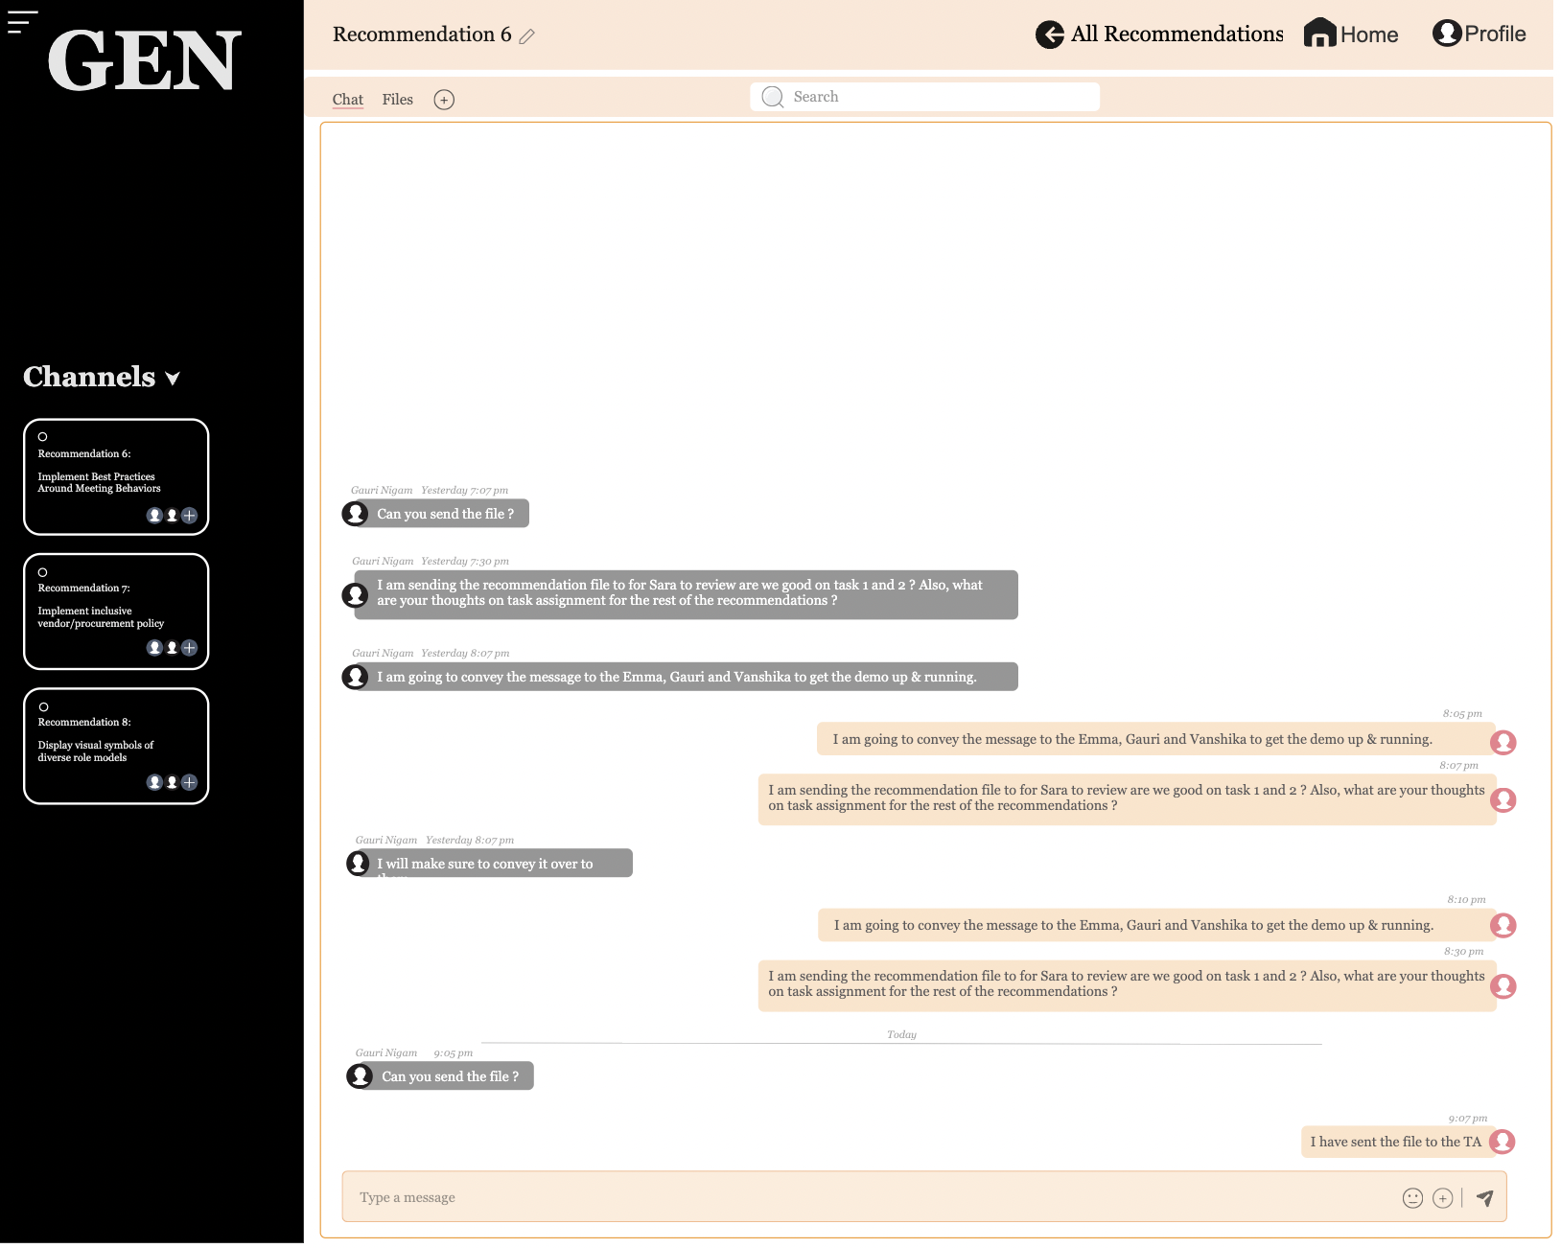
Final Deliverable
Design-Driven Data Smart DEI Dashboard
Deliver a fully functional and user-friendly dashboard prototype that enhances the certification process and supports dynamic tracking and management.

Slide 12
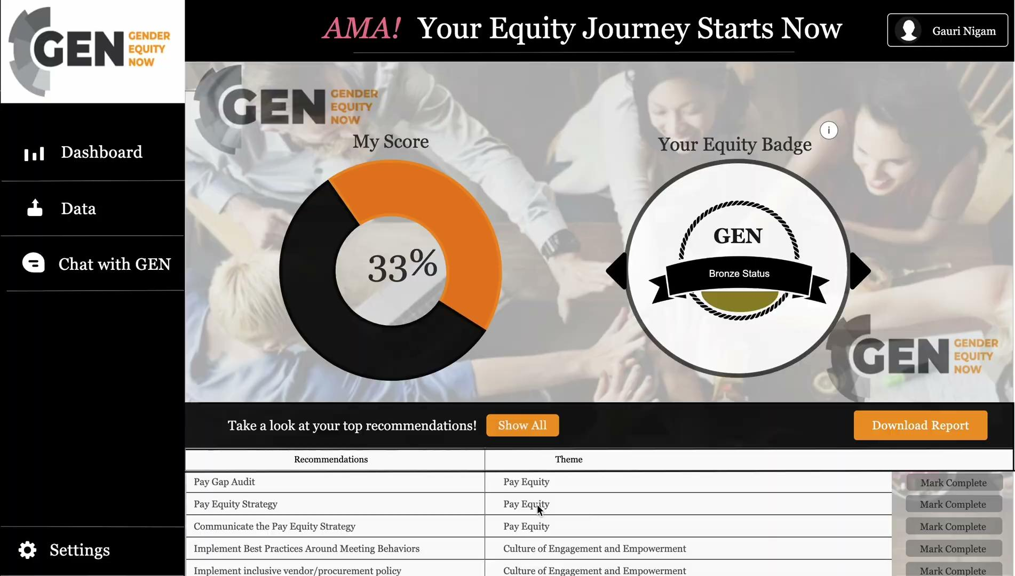

Slide 13
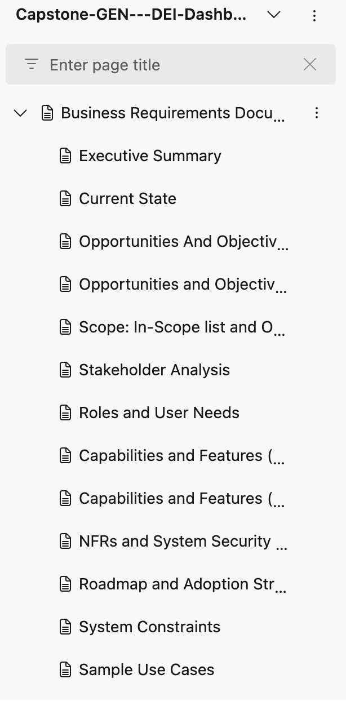

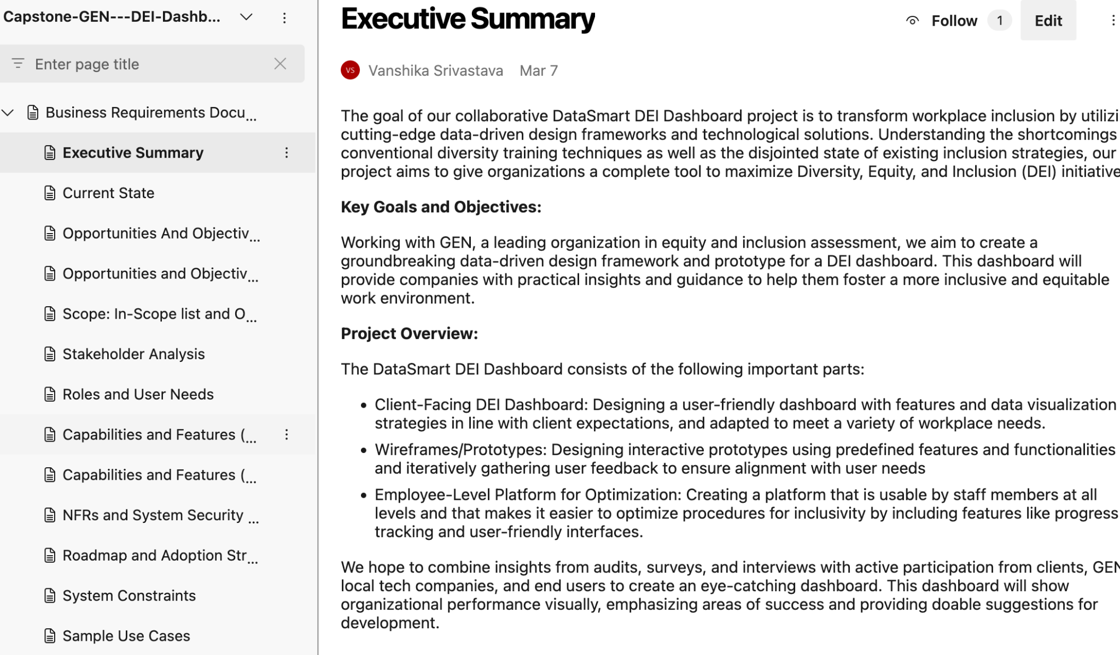

Business Requirement Document

Slide 14




Key Benefits
DEI in one platform
Design that Empowers People
Improved certification time
Interactive insight
Consolidates all certification data into one platform, increasing data retrieval efficiency by 60%.
Enhance visibility into the certification process, improving team buy-in and participation rates by 25%.
Platform allows for higher collaboration & quick response improving efficiency by upto 50%
Dynamic Progress indication and real time updates and alerts increasing user visibility by 40% at any given point.

Slide 15

Thank you!
Any Questions?

